Slide 1
New Outlet Creation

Slide 2
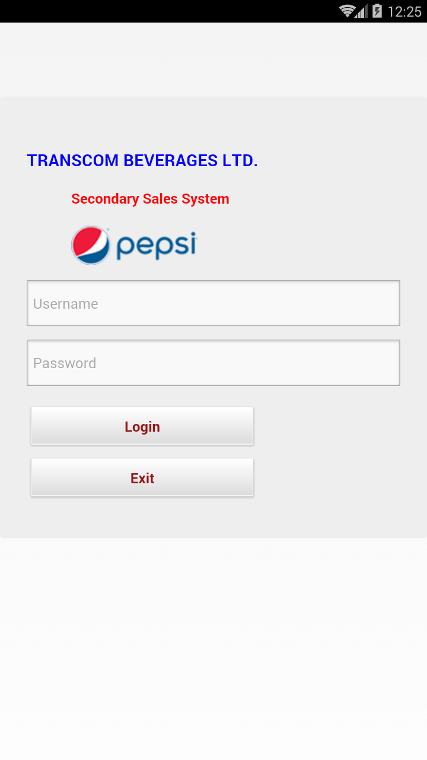
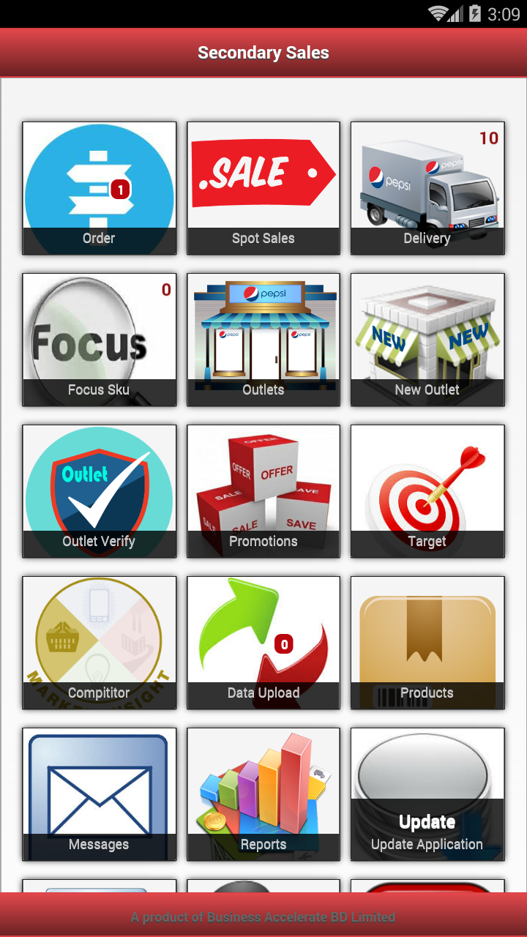
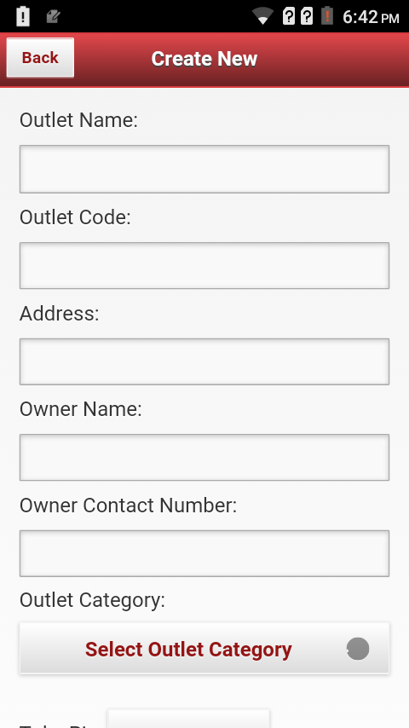
PSR Work Flow.
Click New Outlet
An Enter New Outlet Information
And Click SAVE
PSR Will Log In
Note: PSR can Add New Outlet only on Current Days Sub route.
PSR must Data upload .

Slide 3
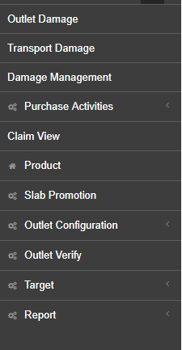
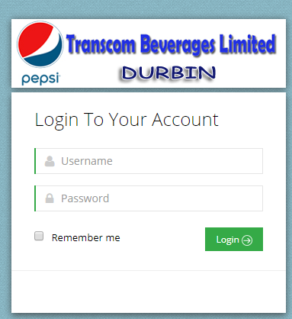
CE Work Flow. For Outlet Approve
Login On Durbin:
Click Outlet Verify

Slide 4
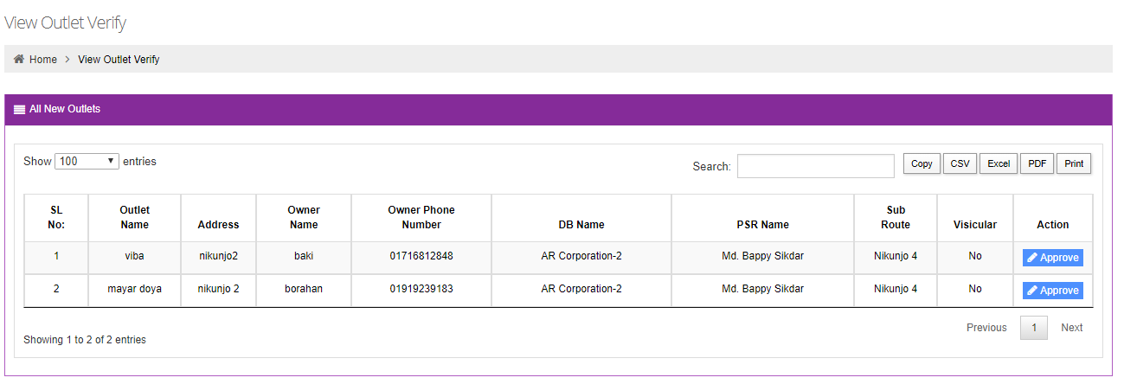
Click Approve

Slide 5
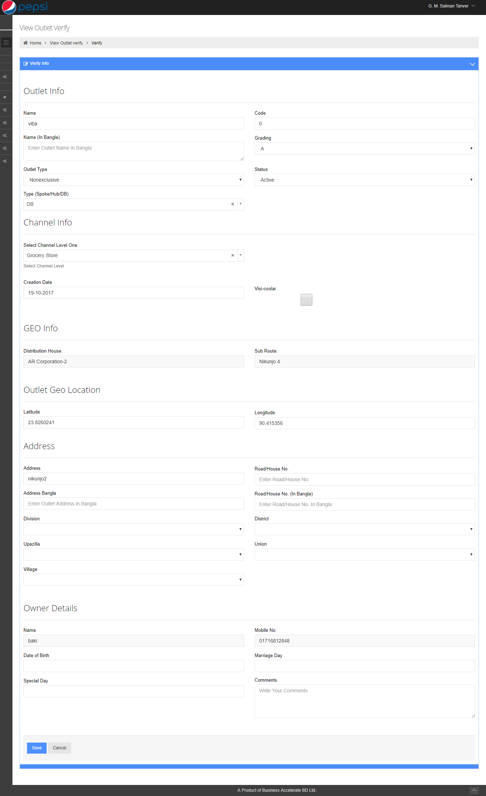
At Bottom Of the Outlet Detail You Have Two Button
If You want To Approve Outlet Click SAVE
If You didn't want To Approve Outlet Click Cancel

